Slide 1
Current and Potential Future Uses of Newborn Stem Cells (Umbilical Cord Blood and Tissue)
Michelle McDougle MS, CGC
mmcdougle@cordblood.com

Slide 2
Disclosures
Michelle McDougle is a full-time employee of CBR, a California Cryobank Company.

Slide 3
Objectives
Define key terms
Summarize current treatments and recent literature
Compare public and private banking options
Examine applicable Texas legislature

Slide 4
Types of Stem Cells
Totipotent
Pluripotent
Multipotent
Zygote/Early Morula
Blastocyst
Specific Lineage

Slide 5
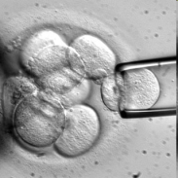
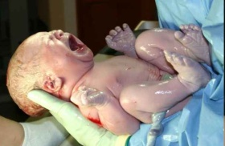
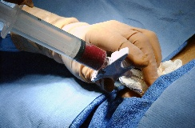
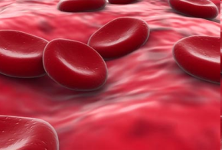
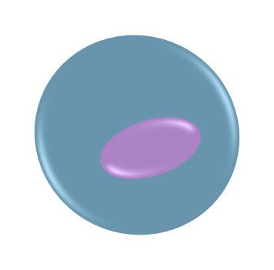
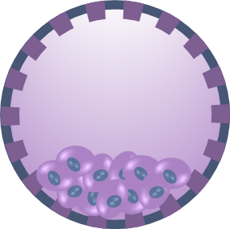
Sources of Stem Cells
0
1yr
60yrs
Embryonic
7 Days
Newborn
272 Days
Adult
Harvested after the newborn period
Pluripotent
Multipotent

Slide 6
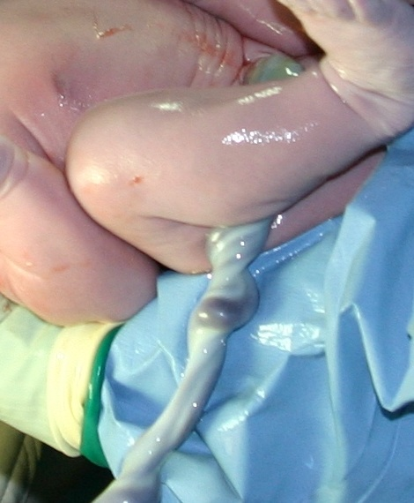
Why Preserve Cord Blood?
Hematopoietic Stem Cells (HSCs)
More stem cells
Platelets
Red blood cells
White blood cells

Slide 7
Why Preserve Cord Tissue?
Mesenchymal Stem Cells (MSCs)
Muscle cells
Osteocytes
More stem cells
Epithelial cells
Adipose

Slide 8
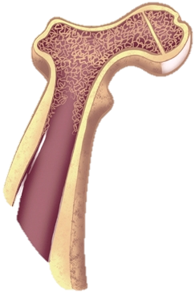
Transplant Medicine
Platelets
Red blood cells
HSC
White blood cells

Slide 9
Cord Blood Use in Transplant Medicine
Over 80 diseases may be treated with a stem cell transplant, including:
Hemoglobinopathies | Mucopolysaccharidoses
b-Thalassemia major | Hurler’s disease (MPS-1)
a-Thalassemia major | Hurler-Scheie syndrome
Sickle cell anemia | Hunter disease (MPS-II)
 | Sanfillippo B (MPS-IIIB)
Immunodeficiencies | Morquio (MPS-IV)
SCID | Maroteaux-Lamy syndrome (MPS-VI)
Bare lymphocyte syndrome | Sly syndrome (MPS-VII)
Chronic granulomatous disease
Wiskott-Aldrich syndrome | Mucolipidoses
Infantile agranulocytosis (Kostman’s syndrome) | Fabry disease
Lazy leukocyte syndrome (neutrophil actin deficiency) | Gaucher disease
Neutrophil membrane GP-180 deficiency | Krabbe disease
Agammaglobulinemia | Metachromatic leukodystrophy
X-linked lymphoproliferative syndrome | Niemann-Pick disease
X-linked hyper-IgM syndrome | Adrenal leukodystrophy
 | I-cell mucolipidosis II
Other Hematopoietic Diseases
Osteopetrosis
Diamond-Blackfan syndrome
Fanconi anemia
Notes:
References:
https://parentsguidecordblood.org/en/diseases.
2. Butler MJ and Menitove JE. J Assist Reprod Genet. 2011, Aug;28(8).

Slide 10
Stem Cell Donors
Autologous
Patient’s own stem cells
Allogeneic
Stem cells from healthy donor
Considered safer form of transplant
Not used for genetic conditions
Related or unrelated donors
Can be used for genetic and acquired conditions

Slide 11
Donor Selection for Stem Cell Transplants
Treating physician first looks within the family for a possible stem cell donor
If no relatives are suitable donors, the search expands to the public system
Most, but not all, patients can find a donor in the public system
Search could prolong time to treatment
Adult sources require 8/10 HLA match
Cord blood stem cells are less mature and can tolerate 3/6 HLA match

Slide 12
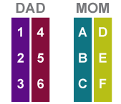
HLA Matching in a Family
75% chance that a sibling will be AT LEAST a 3/6 match

Slide 13
Regenerative Medicine
Tissue Engineering
Muscle
Cartilage
Bone

Slide 14
Regenerative Medicine
Gene Therapy
Genetically-repaired autologous cells transplanted back into patient
Autologous cord blood stem cells carrying disease-causing mutation
Healthy gene transduced into stem cells in culture

Slide 15
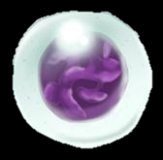
Regenerative Medicine
Paracrine Effect
Promotes
Cell survival
Proliferation
Repair/replacement of blood vessels
Reduces
Cell death
Inflammation

Slide 16
Pre-clinical Cord Blood Research: HIE
Study objective: to investigate the potential of hUCB mononuclear cells to facilitate motor function recovery after hypoxic-ischemic (HIE) brain damage in neonatal rats
Three groups: controls, lesion without transplant, lesion with intraperitoneal injection of hUCB.
Notes:
Reference:
Meier et al. Pediatric Research. 2006 Feb; 59(2):244-9.

Slide 17
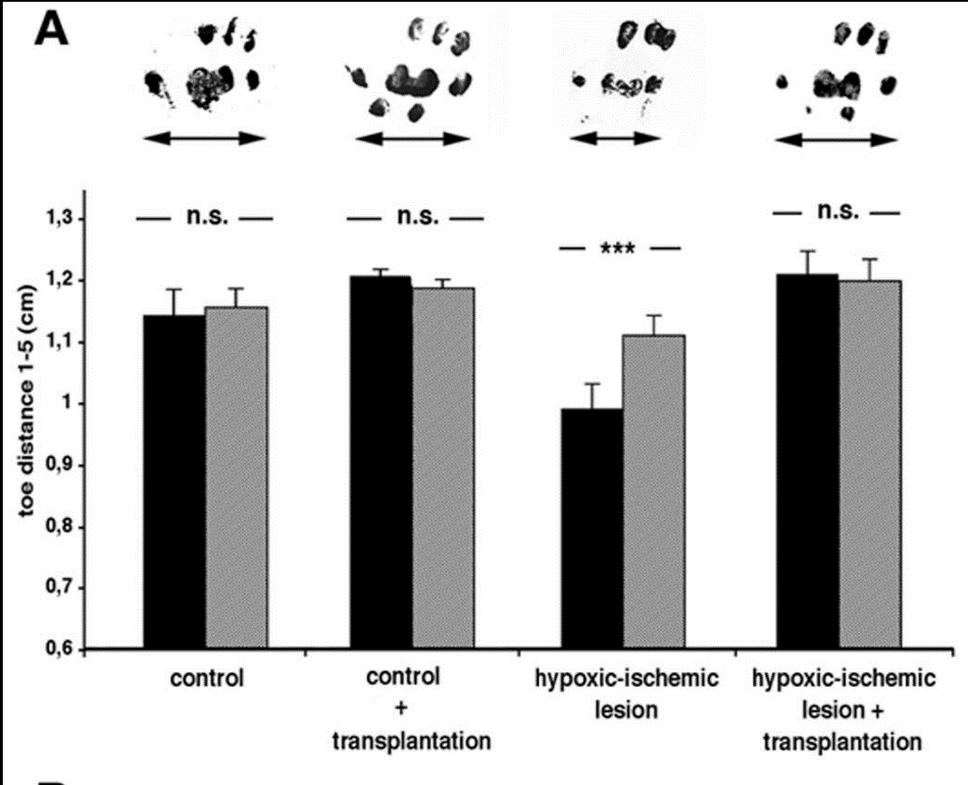
Reduction in Symptoms
hUCB transplantation decreased spasticity as measured by footprint width and step length
Foot print width
n.s. = not significant
*** = p <0.001
* = p<0.05
Step length
Notes:
Animals in this study were tested functionally for the development of spasticity, which was measured here by both paw width and step length.
A: HIE results in spastic paresis of the distal limb muscles causing a significant reduction of footprint width of the right hind paw (contralateral to the insult; black columns) compared to the left (ipsilateral to insult, gray columns). Intraperitoneal transplantation of hUCB mononuclear cells after HIE reduced spastic paresis. In these animals, the ipsi/contralateral differences were no longer detected. (This is shown by the –n.s- label in the bar graphs).
B: In control animals with and without transplantation, the step length of left and right hind paws is equal. In contrast, HIE resulted in a significantly reduced step length if the right hind paw (black columns) compared to the left hind paw (gray). This reduction in step length was largely alleviated in the transplantation group. (Shown by the * label in the bar graphs).
Reference:
Meier et al. Pediatric Research. 2006 Feb; 59(2):244-9.

Slide 18
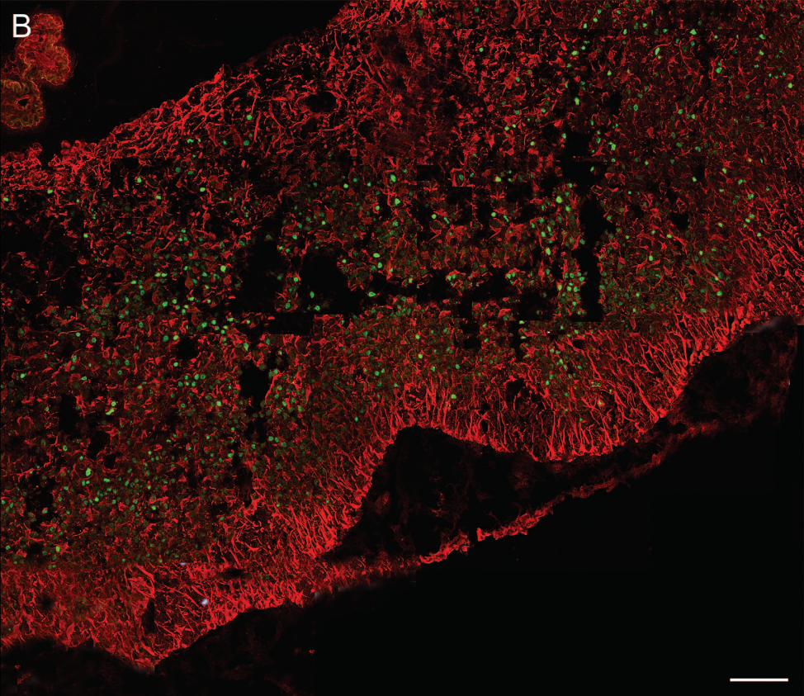
Cells Home to Site of Brain Lesion
Notes:
Schematic representation of the distribution of human cells in the lesioned hemisphere. HLS-DR-positive cells (green) are detected in the area of the hypoxic-ischemic lesion. Contralateral hemispheres were devoid of human cells. Immunohistochemistry is demonstrated for boxed areas in B (lesioned hemisphere) and C (nonlesioned hemisphere).
HLA-DR-positive mononuclear cells (green) are located within a scaffold of GFAP-positive astrocytes (red) in the area of the hypoxic-ischemic lesion.
) Nonlesioned parts of the brain, as demonstrated by the absence of inflammatory and apoptotic events (compare Fig. 2), are devoid of human cells (absence of green fluorescence).
Lesioned areas of the brain of animals that did not receive transplantation of human cells are devoid of HLS-immunostaining. Note absence of green immunofluorescence (HLA-staining) within the red scaffold of GFAP-positive rat astrocytes. Scale bar in B, C: 100 μm; in D: 20 µm.”
Also, the UCB cells did not show any obvious signs of differentiation into neural cells, as assessed by phenotype but lack of presence of GFAP (specific to neuron-specific proteins or neural progenitor cells).
Reference:
Meier et al. Pediatric Research. 2006 Feb; 59(2):244-9.

Slide 19
Cord Blood Research in Regenerative Medicine
Regenerative Indications | Ischemic Injury
- Type 2 Diabetes | - Stroke
- Spinal Cord Injury | - Hypoxic Ischemic Encephalopathy
- Hypoplastic Left Heart Syndrome | - Critical Limb Ischemia
Neurological/Brain Injury | Autoimmune Disorders
- Cerebral Palsy | - Type 1 Diabetes
- Autism
- Sensorineural Hearing Loss
- Hydrocephalus
- Developmental Delay

Slide 20
MSC Research in Regenerative Medicine
Skeletal Disease/Injury | Regenerative Indications | Ischemic Injury
- Bone Fractures | - Heart disease and failure | - Myocardial Infarction
- Cartilage Injury | - Type 2 Diabetes | - Stroke
- Osteoarthritis | - Cirrhosis of the Liver | - Coronary Artery Disease
- Osteogenesis Imperfecta | - Spinal Cord Injury | - Critical Limb Ischemia
- Osteodysplasia | - Bronchopulmonary Disease - Cleft lip/palate
Autoimmune Disorders | Inflammatory Conditions | Recovery from Transplant
- Type I Diabetes | - Chronic Obstructive | - HSC Engraftment
- Multiple Sclerosis | Pulmonary Disease (COPD) | - Prevention/Treatment of
- Systemic Lupus | - Crohn’s Disease | Graft vs Host Disease
Erythematosus |  | - Prevention/Treatment of
- Degenerative Disc Disease |  | Donor Organ Rejection

Slide 21
Recent Publications
Autism | Duke: Phase I open label trial 25 children age 2-6 years; single autologous CB infusion
 | Duke: EEG data from Phase I trial Results from EEGs performed on previous cohort
 | Duke: MRI data from Phase I trial Results from MRIs performed on previous cohort
 | Sutter Health: Phase II placebo-controlled trial 29 children age2-6 years; single autologous CB infusion
Cerebral Palsy | Duke: Phase II placebo-controlled trial 63 children age 1-6 years; single autologous CB infusion
Acquired Hearing Loss | FL Hospital for Children: Phase I open label trial 10 children 6mos to 6yrs; single autologous CB infusion
Cord Tissue Health | CBR: Analysis of composite umbilical cord tissue health Explant and metabolic activity used to measure post-thaw viability of cord tissue
Family Health Registry | CBR: Data from Family Health Registry 94,803 CBR families responded to survey; 16% indicated presence of condition potentially amenable to cellular therapy

Slide 22
What are the Options?
Discard | Public Donation | Family Bank | Medical Need
An estimated 95% of cord blood in the US is discarded as medical waste | Families donate their cord blood for a patient in need No cost to donate Option must be available at the delivering hospital | Families save cord blood/tissue for their own potential future use Initial cost for sample processing and yearly storage fee | Families save cord blood/tissue at reduced or no cost on behalf of a family member who has a disease that may be treated with a stem cell transplant

Slide 23
Availability of Public Donation
Currently, 13 Texas hospitals collect cord blood for donation to public bank for listing on the Be The Match Registry - which are made available to any patient in need of a transplant
MD Anderson Cord Blood Bank | GenCure: Texas Cord Blood Bank
Ben Taub General Hospital (Houston) | St. David’s Medical Center (Austin)
Memorial Hermann Hospital Medical Center (Houston) | Medical City Dallas
Memorial Hermann Southwest (Houston) | Women’s Hospital at Renaissance (Edinburg)
St. Joseph Medical Center (Houston) | Christus Santa Rosa (New Braunfels)
The Woman’s Hospital of Texas (Houston) | Christus Santa Rosa – The Children’s Hospital of San Antonio
 | Methodist Hospital (San Antonio)
 | Metropolitan Methodist Hospital (San Antonio)
 | Central Texas Medical Center (San Marcos)

Slide 24
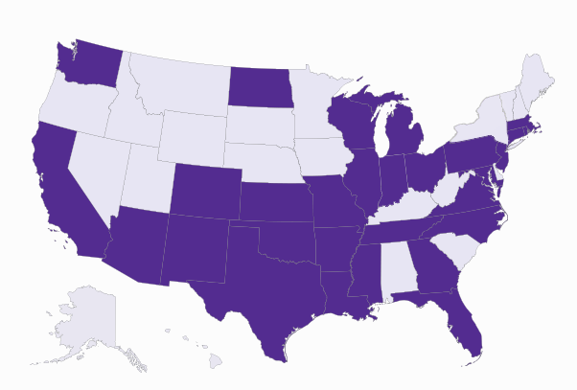
IOM Study Shapes Public Health Policy
In 2005, the Institute of Medicine (IOM) issued a comprehensive report to Congress on cord blood banking.
The report contains clear recommendations that health care professionals should provide all expectant parents with fair and balanced education on cord blood preservation prior to labor and delivery.
The IOM Study has helped to guide health policy at the state level. To date, 29 states have passed some form of cord blood education legislation (shaded on the map). The majority of states follow the IOM recommendations.

Slide 25
Texas Legislature
As of 2008, the Texas Health and Human Services Commission is mandated to promote public awareness of all medically appropriate cord blood options via a brochure
The brochure must be provided by health care professionals to pregnant women before the third trimester, or as soon as reasonably feasible

Slide 26
Questions
Michelle McDougle MS, CGC
mmcdougle@cordblood.com

